Slide 1


Cast 2025
Review & New Variety HIGHLIGHTS

Slide 2
CUT FLOWERs

Slide 3

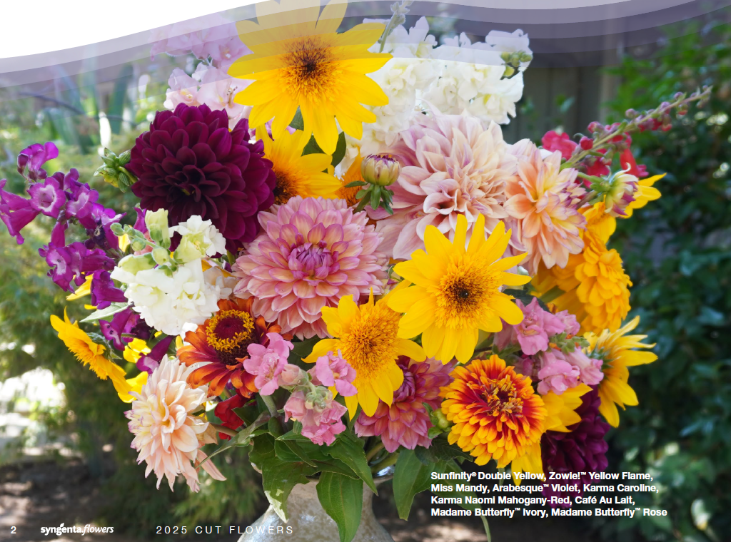
Cut Flowers
Columbine
Dahlia
Delphinium Excalibur
Foxglove Camelot
Lavender
Mums
Nicotiana
Sunflower Sunfinity
Penstemon
Snapdragon
Viola Tiger Eye
Zinnia Zowie

Slide 4
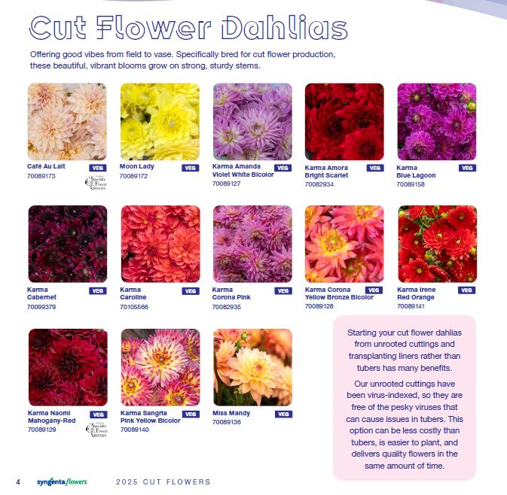
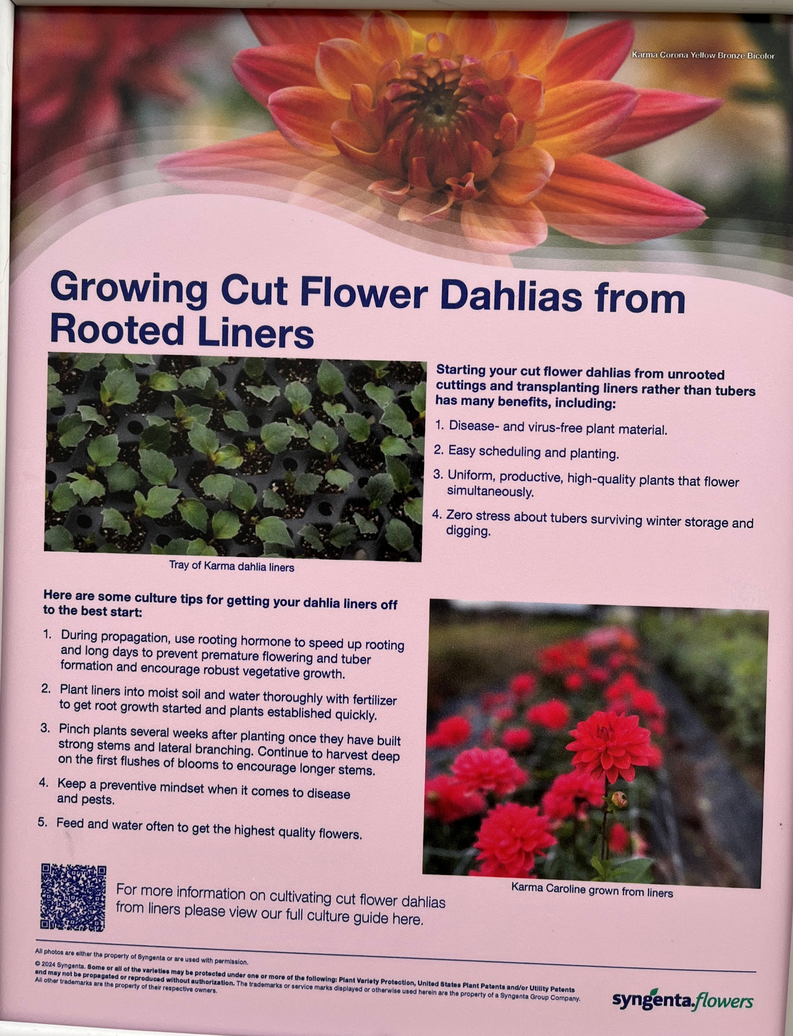

Slide 5
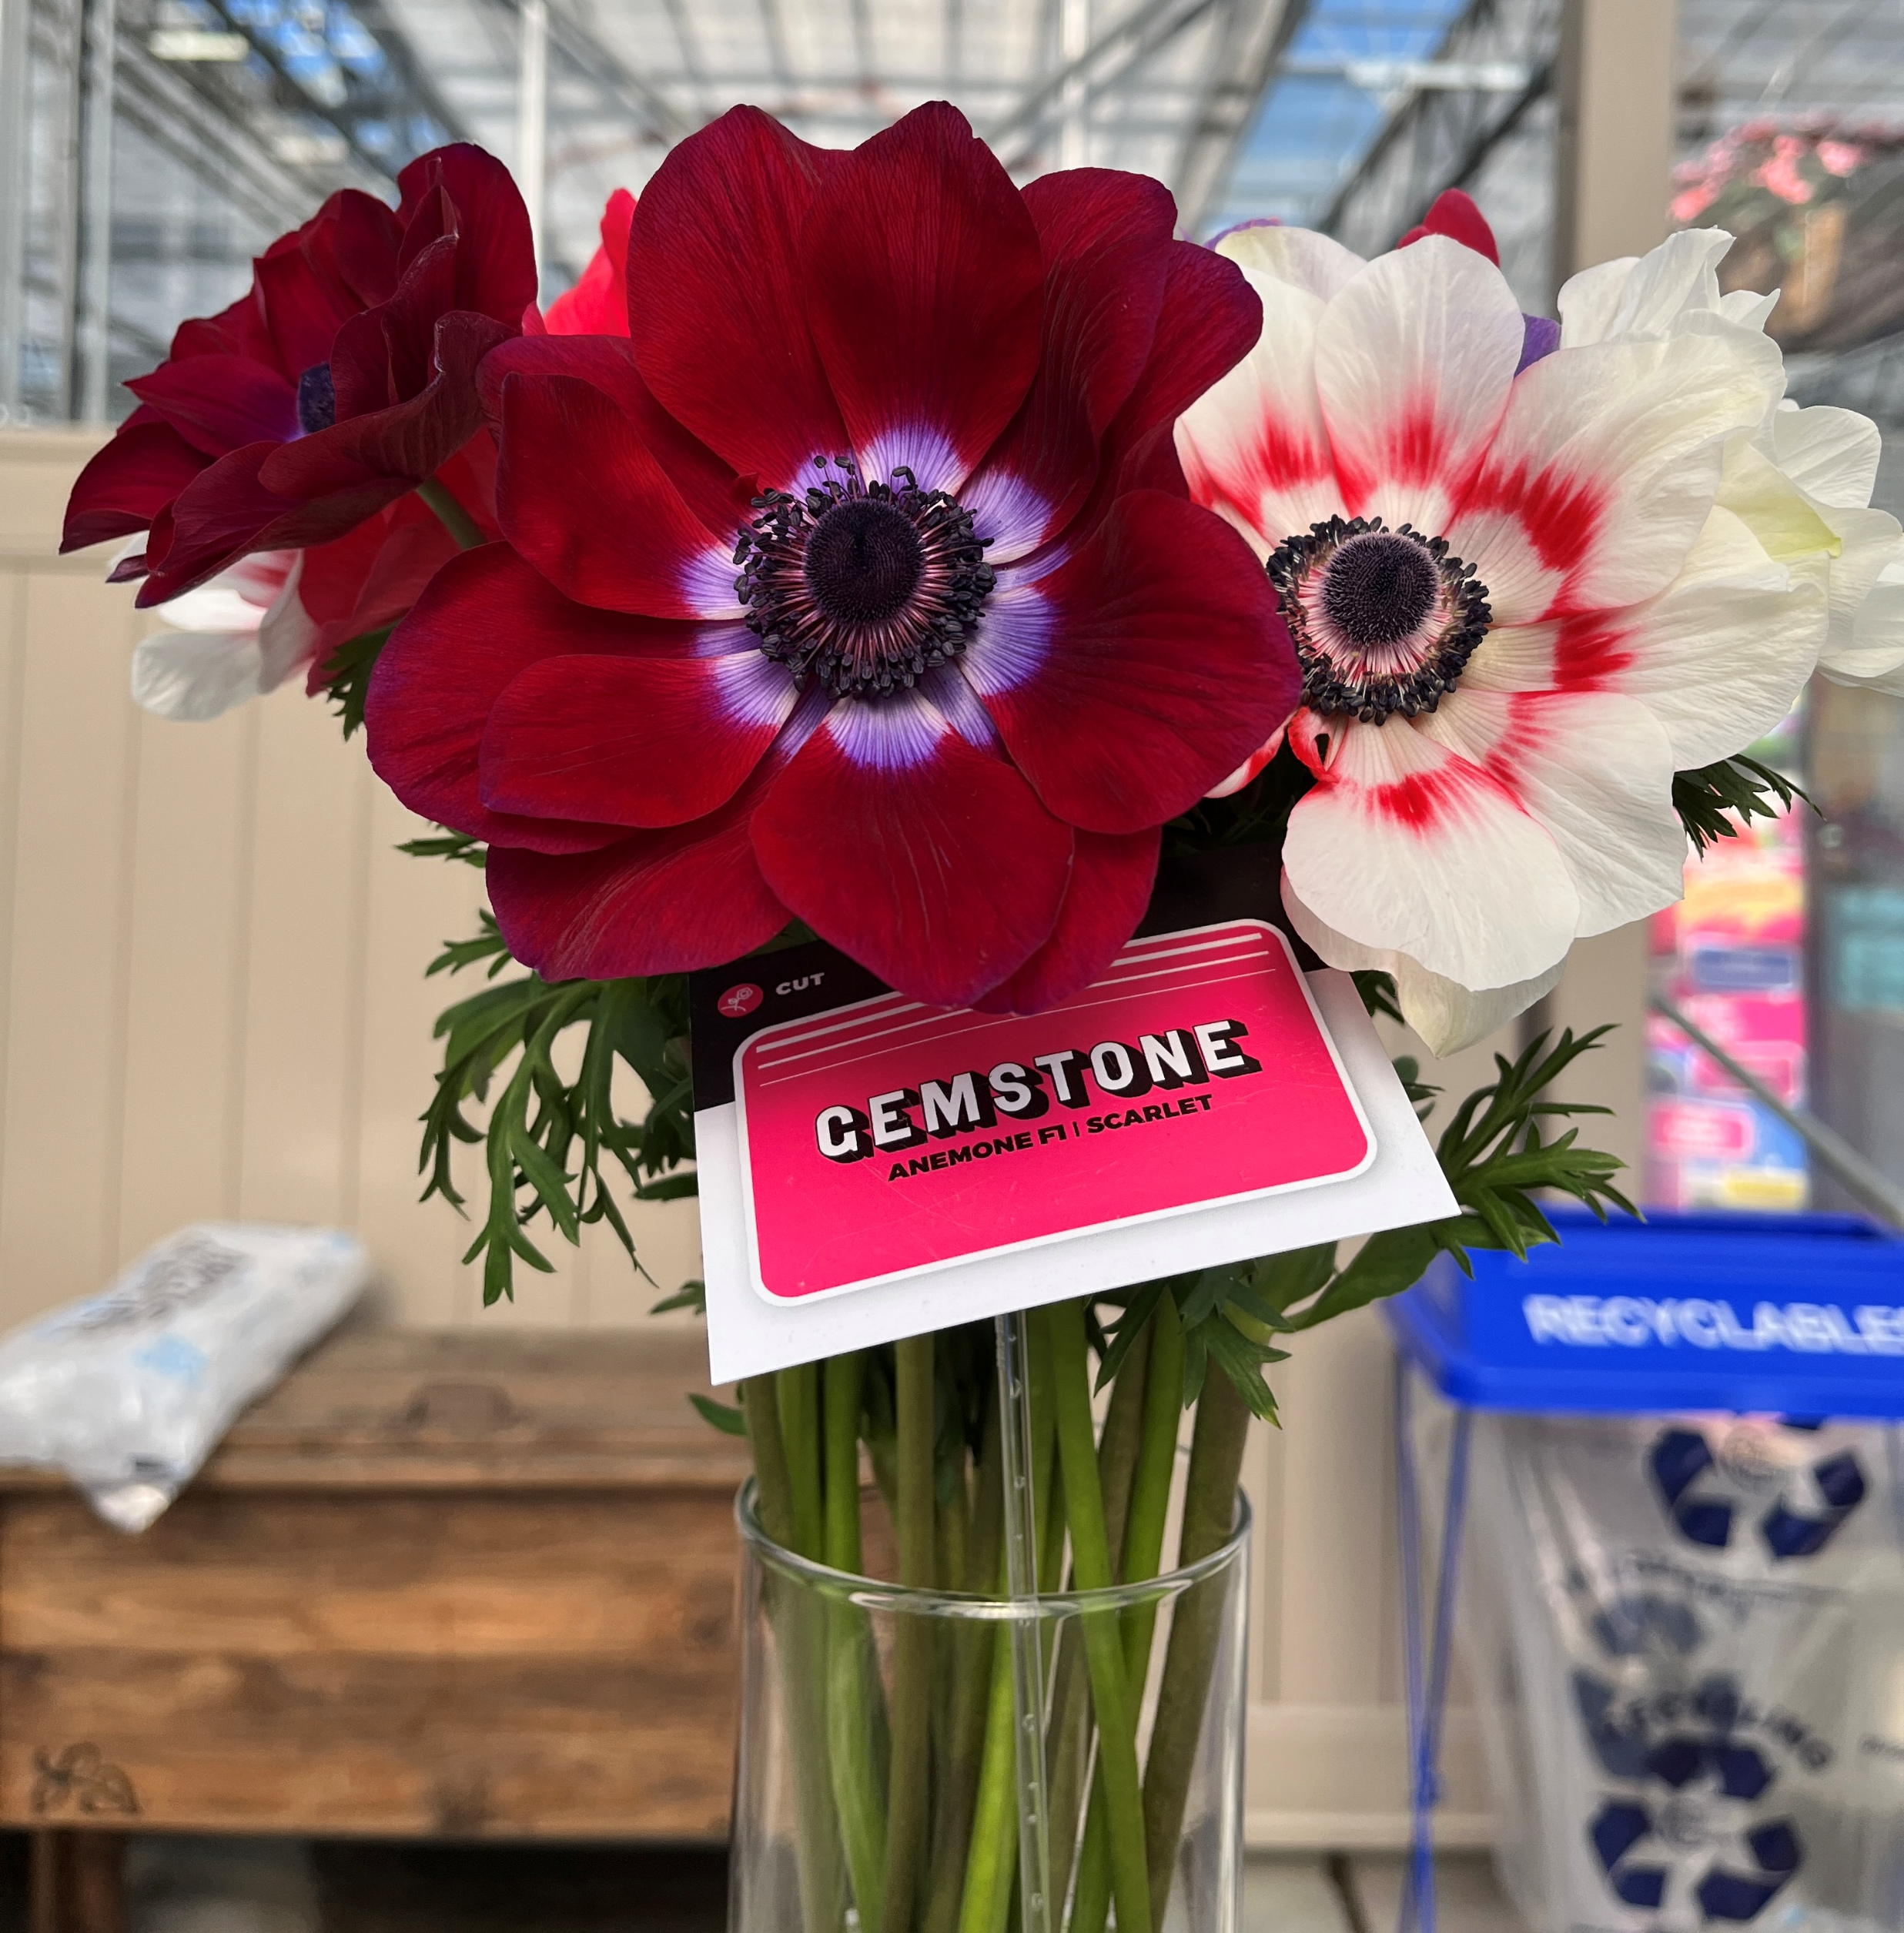

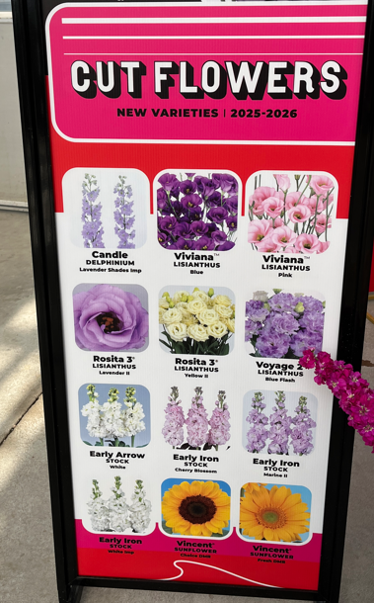
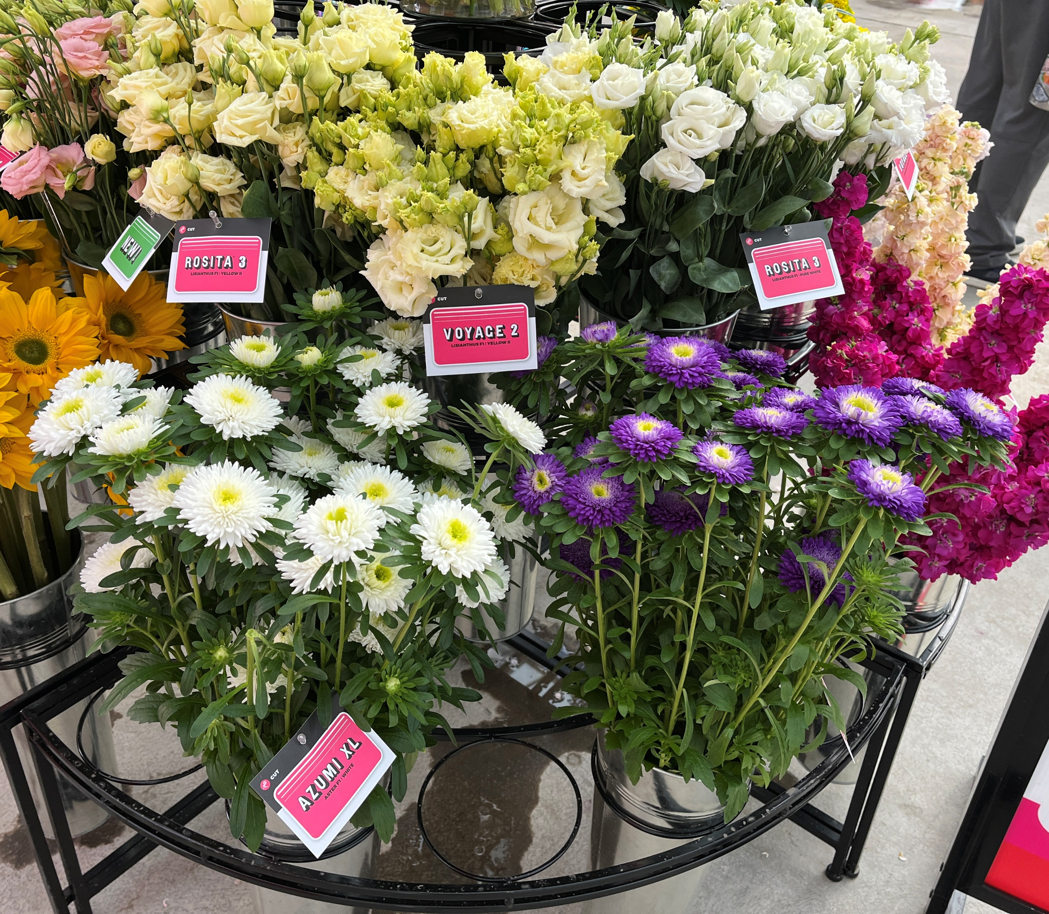
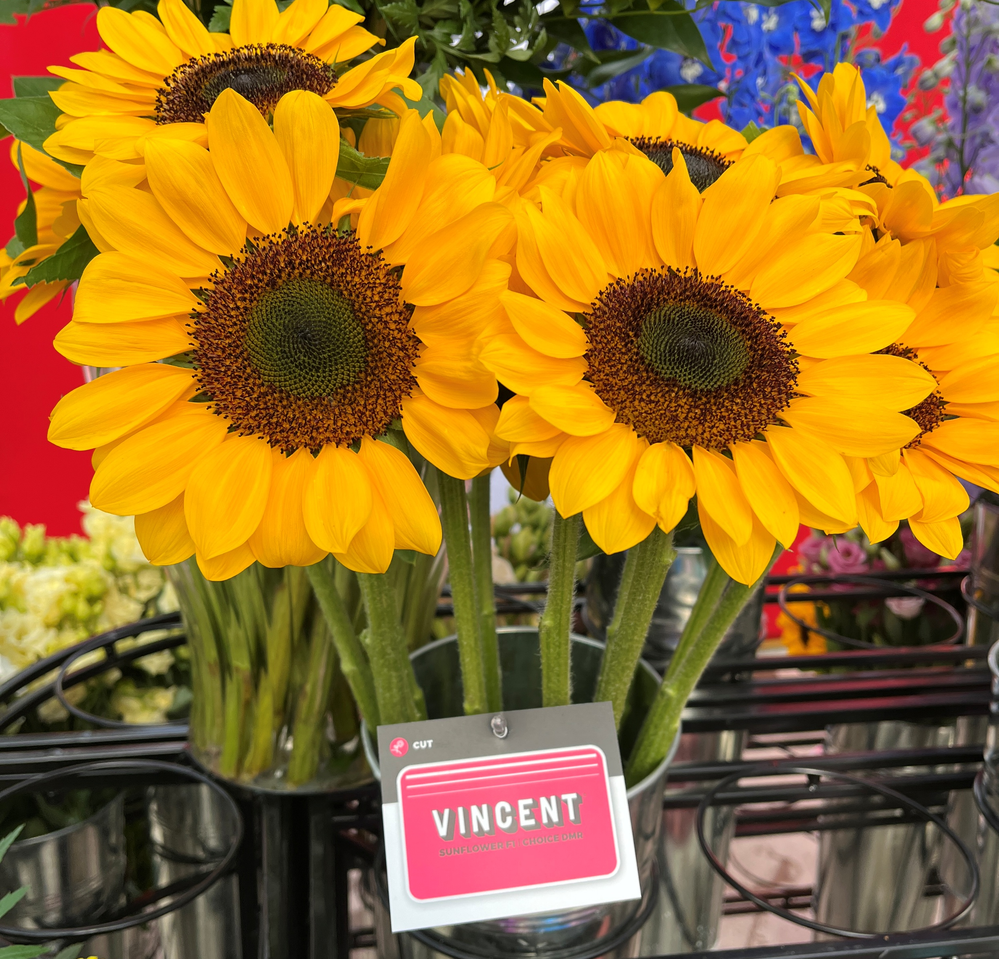
Cut Flowers
Sunflower Vincent stands up with upward facing flowers – Vincent Choice is #1
Lisianthus lots of options including pollen free
Aster Azumi XL = larger flowers, excellent disease tolerance
Anemone Gemstone
Offered to do a webinar on cut flowers if there is any interest

Slide 6

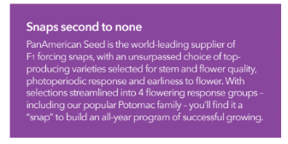

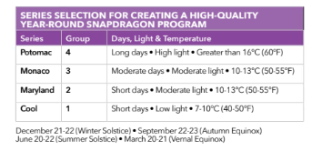
Cut Flowers
Celosia
Delphinium
Dianthus
Lisianthus
Matthiola (Stock)
Snapdragons

Slide 7

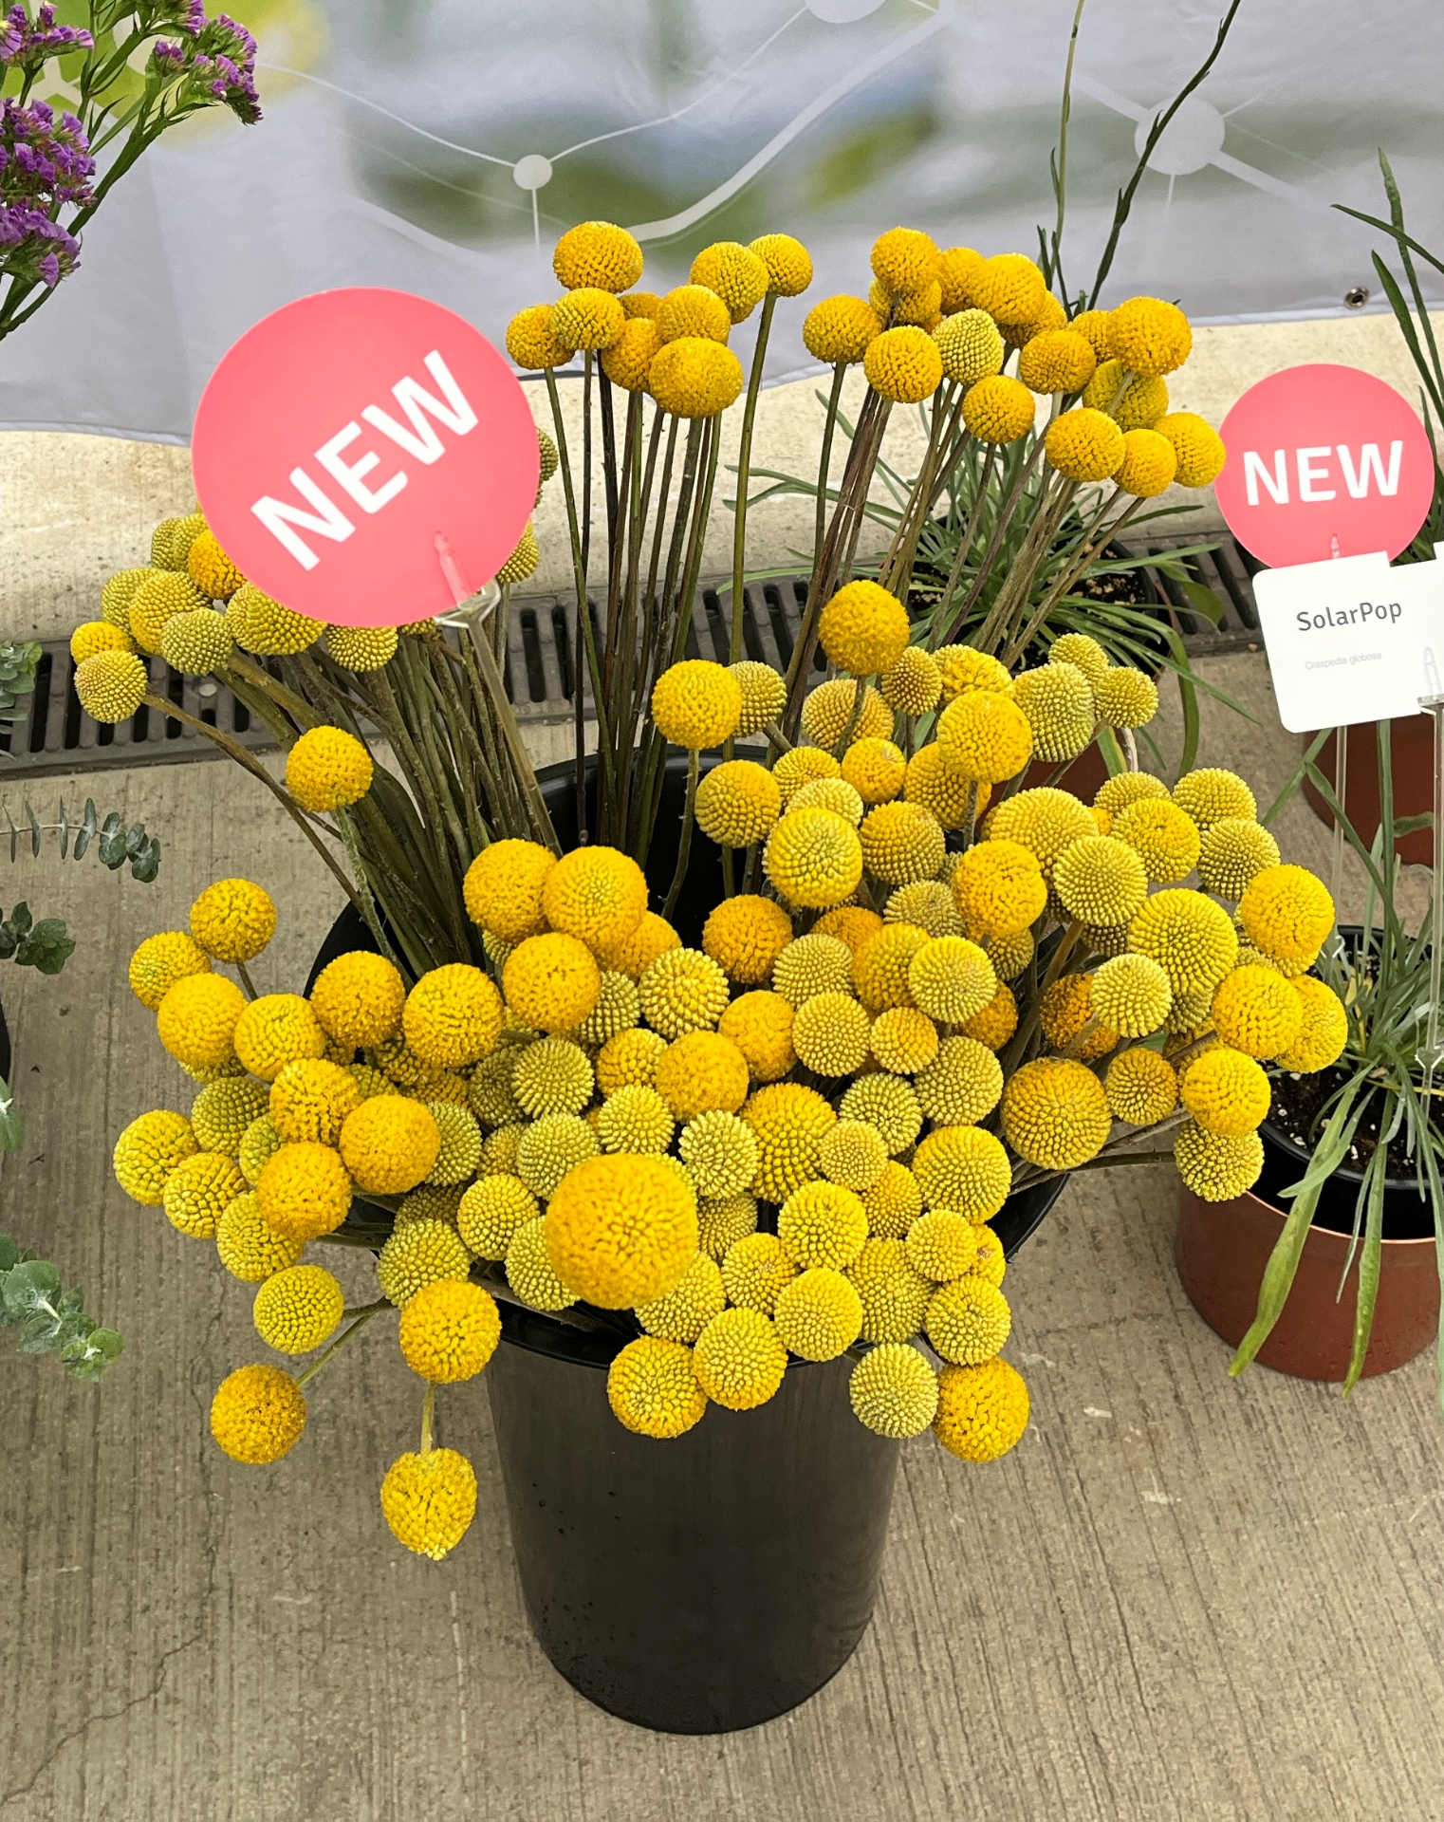
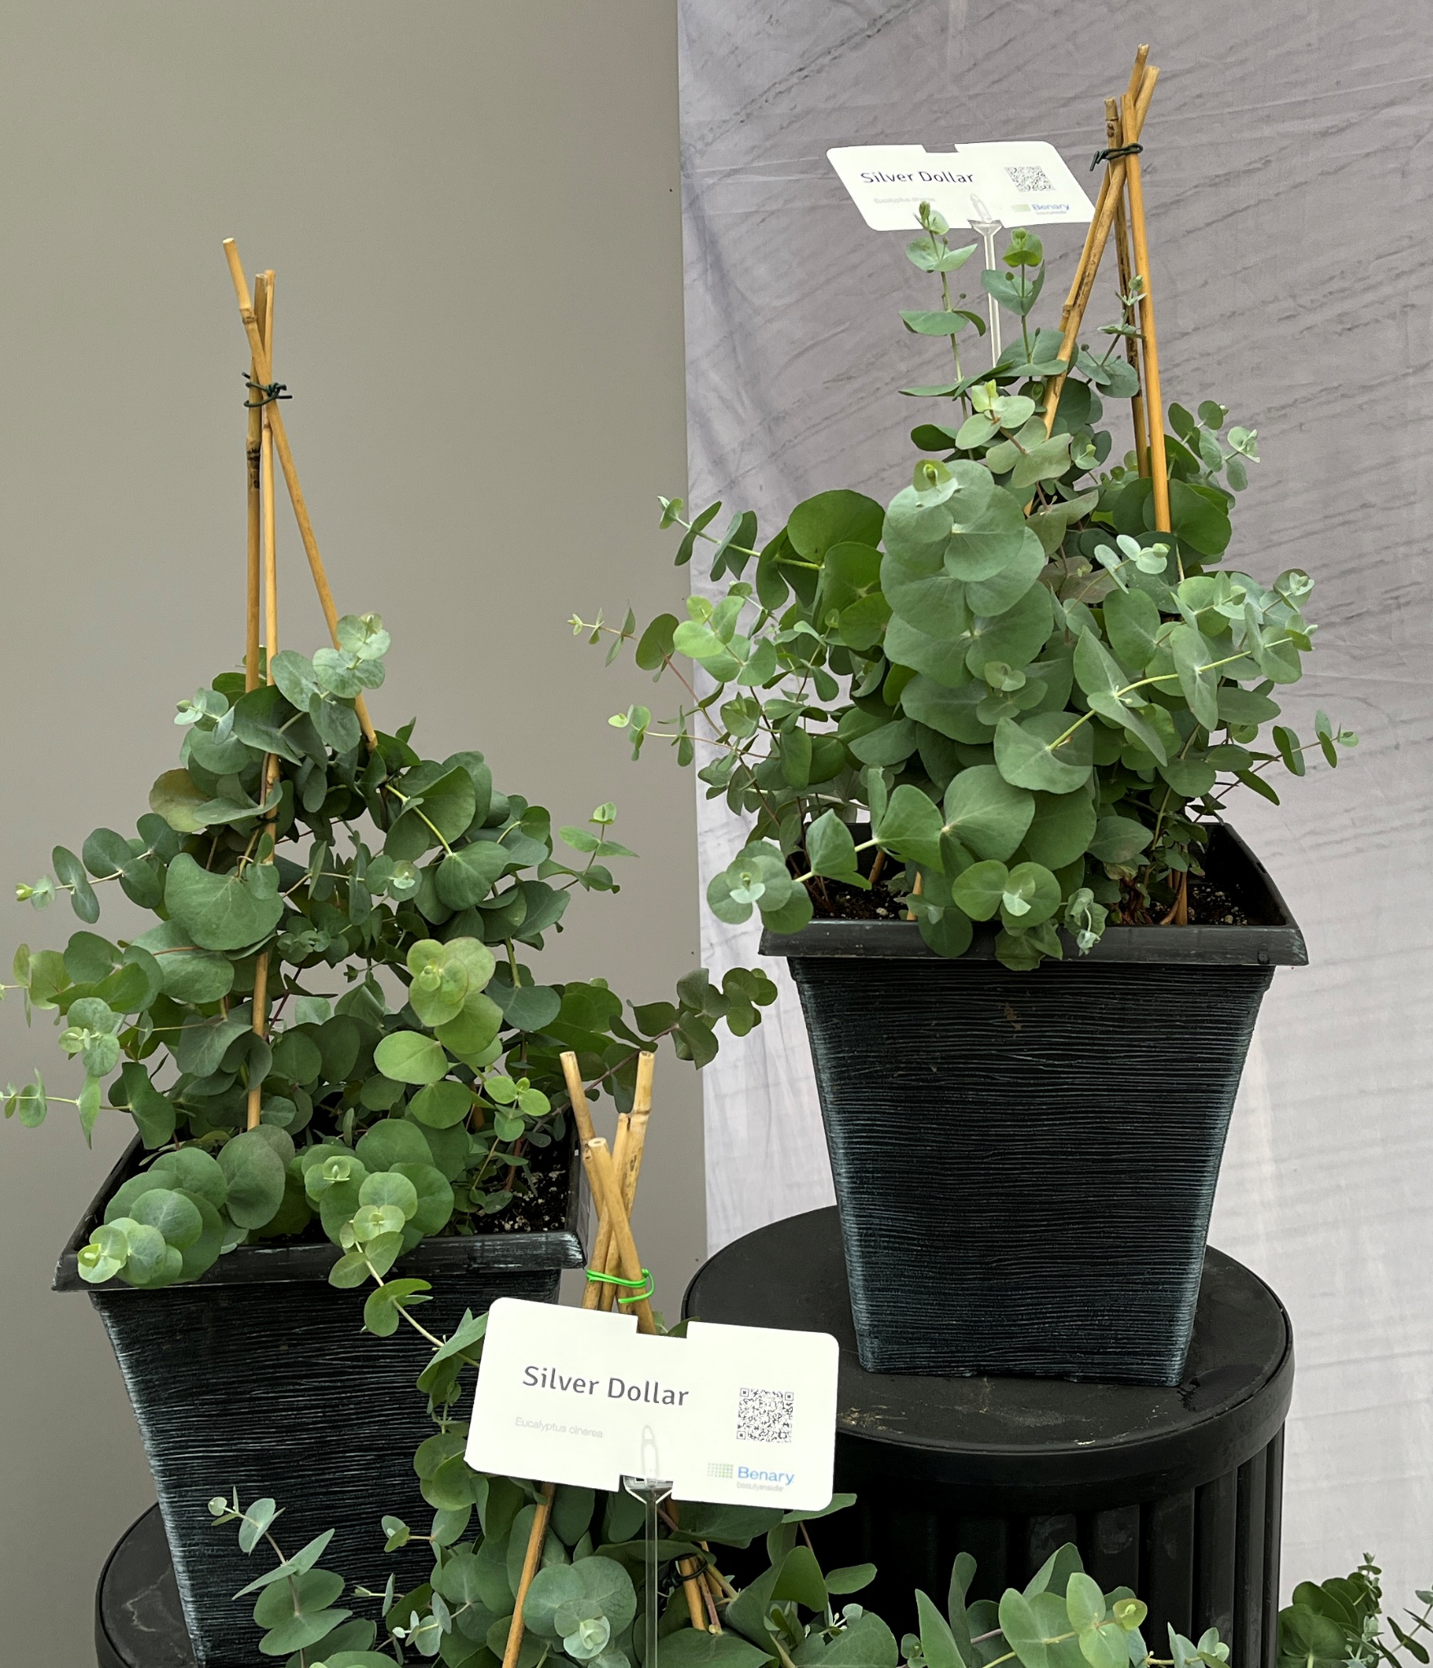
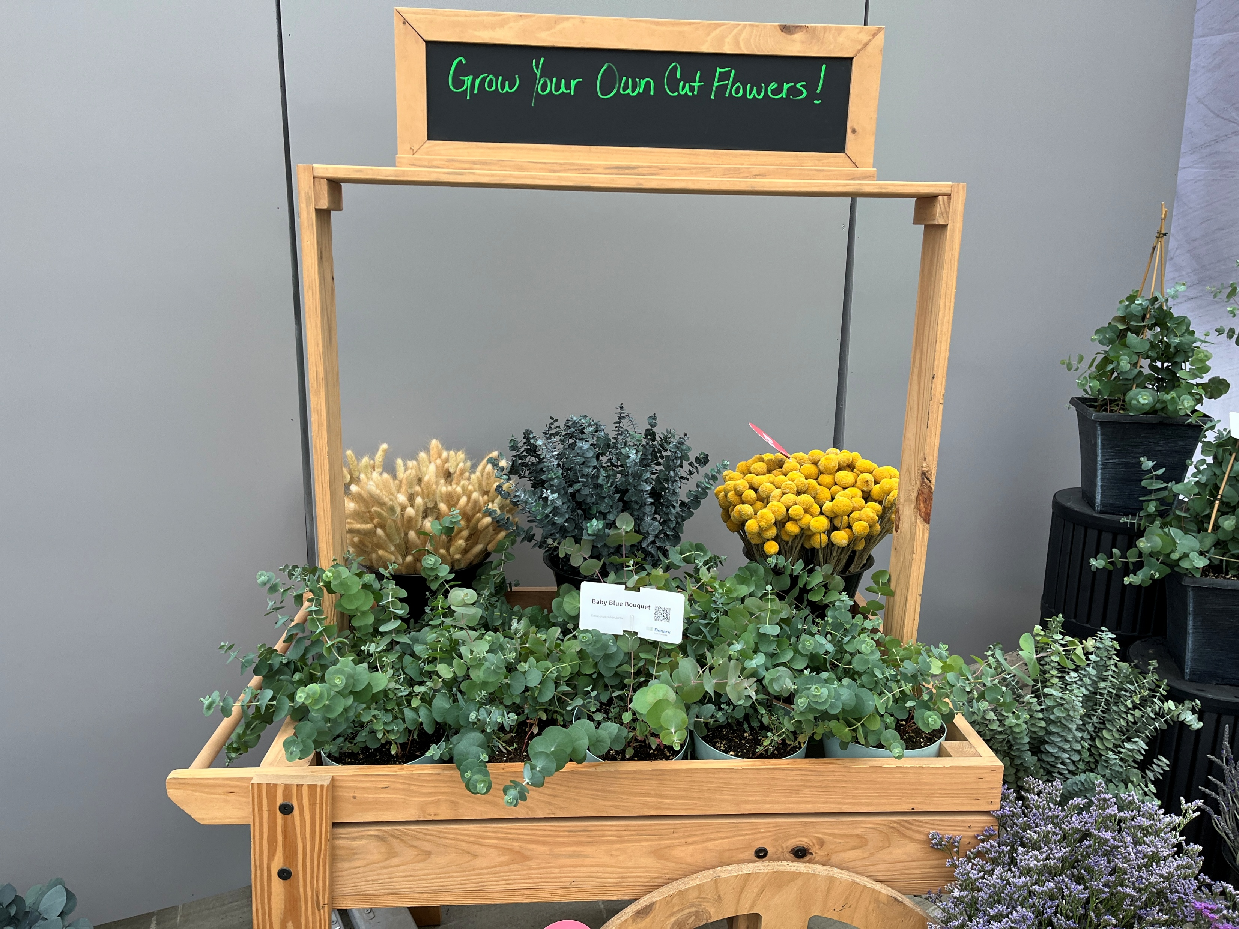
Cut Flowers
Famous for Zinnia Benary’s Giant
Eucalyptus Silver Dollar, Baby Blue Bouquet
New Craspedia SolarPop

Slide 8

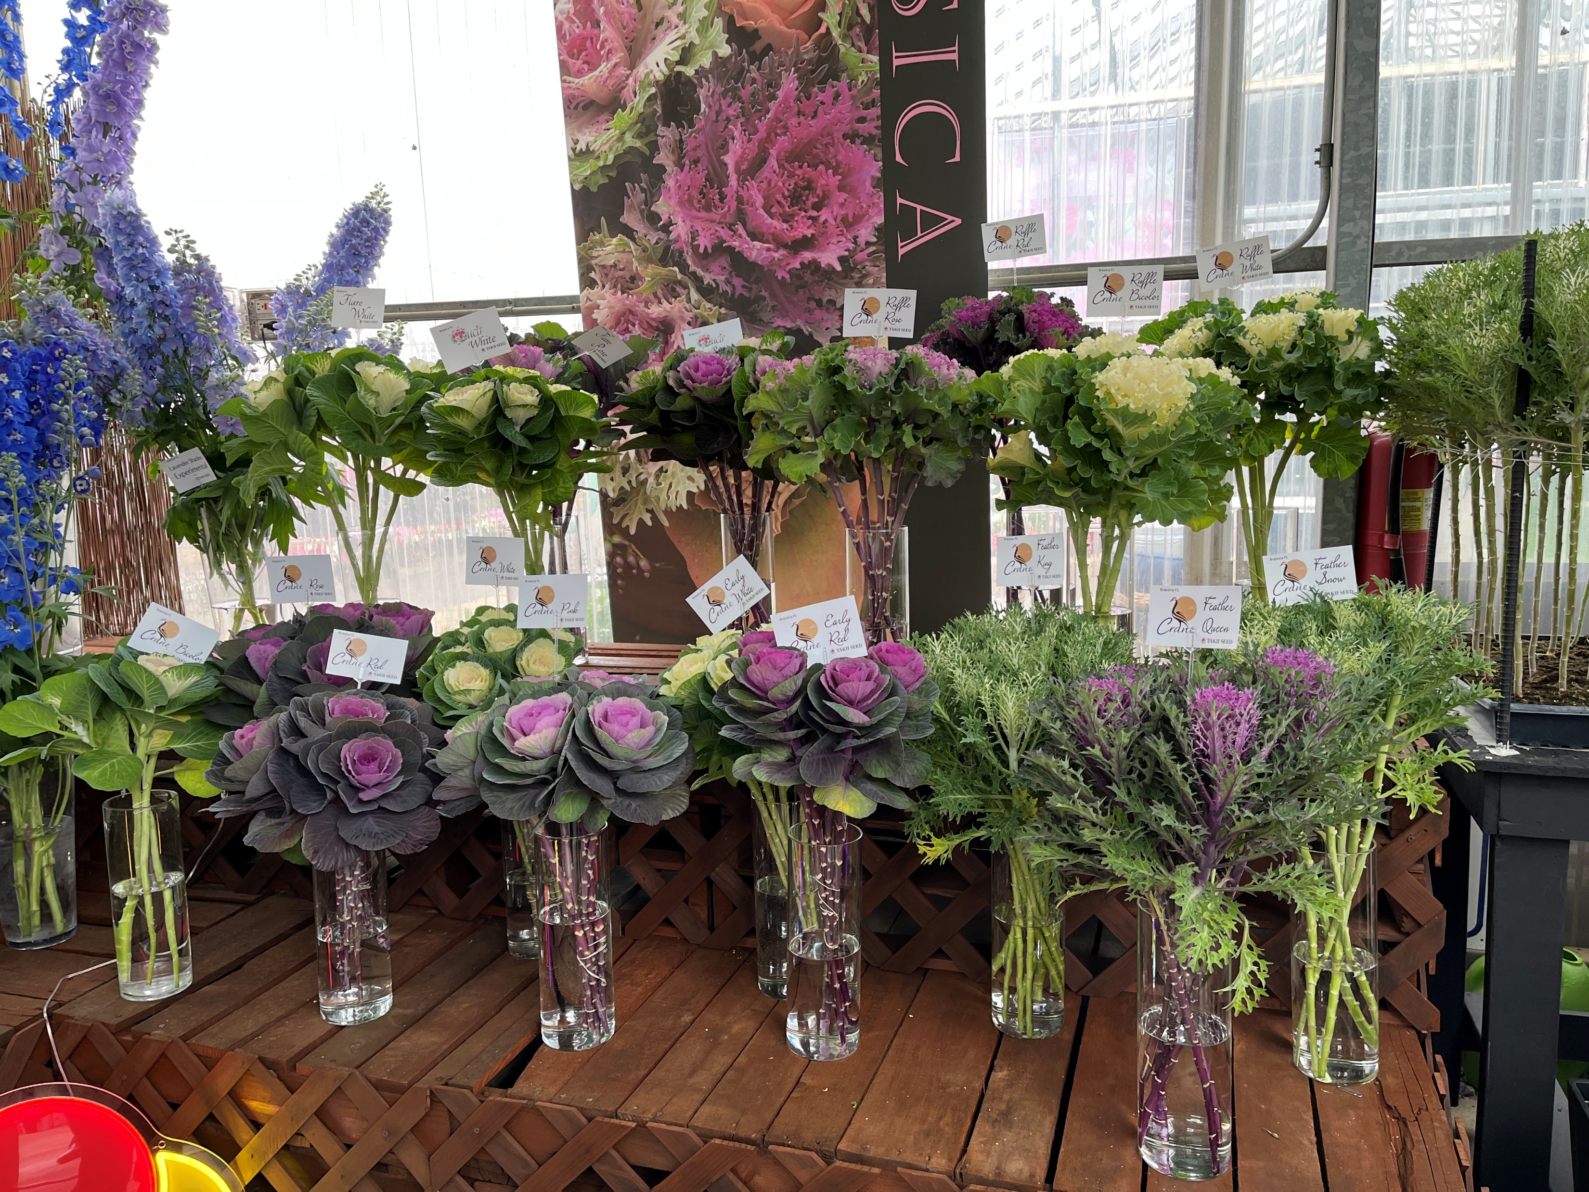
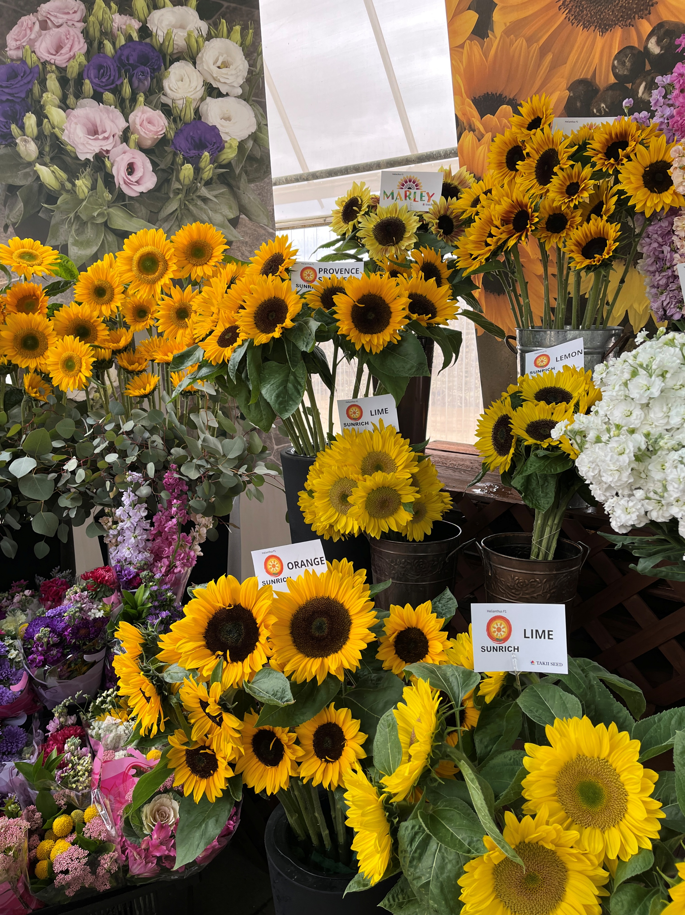
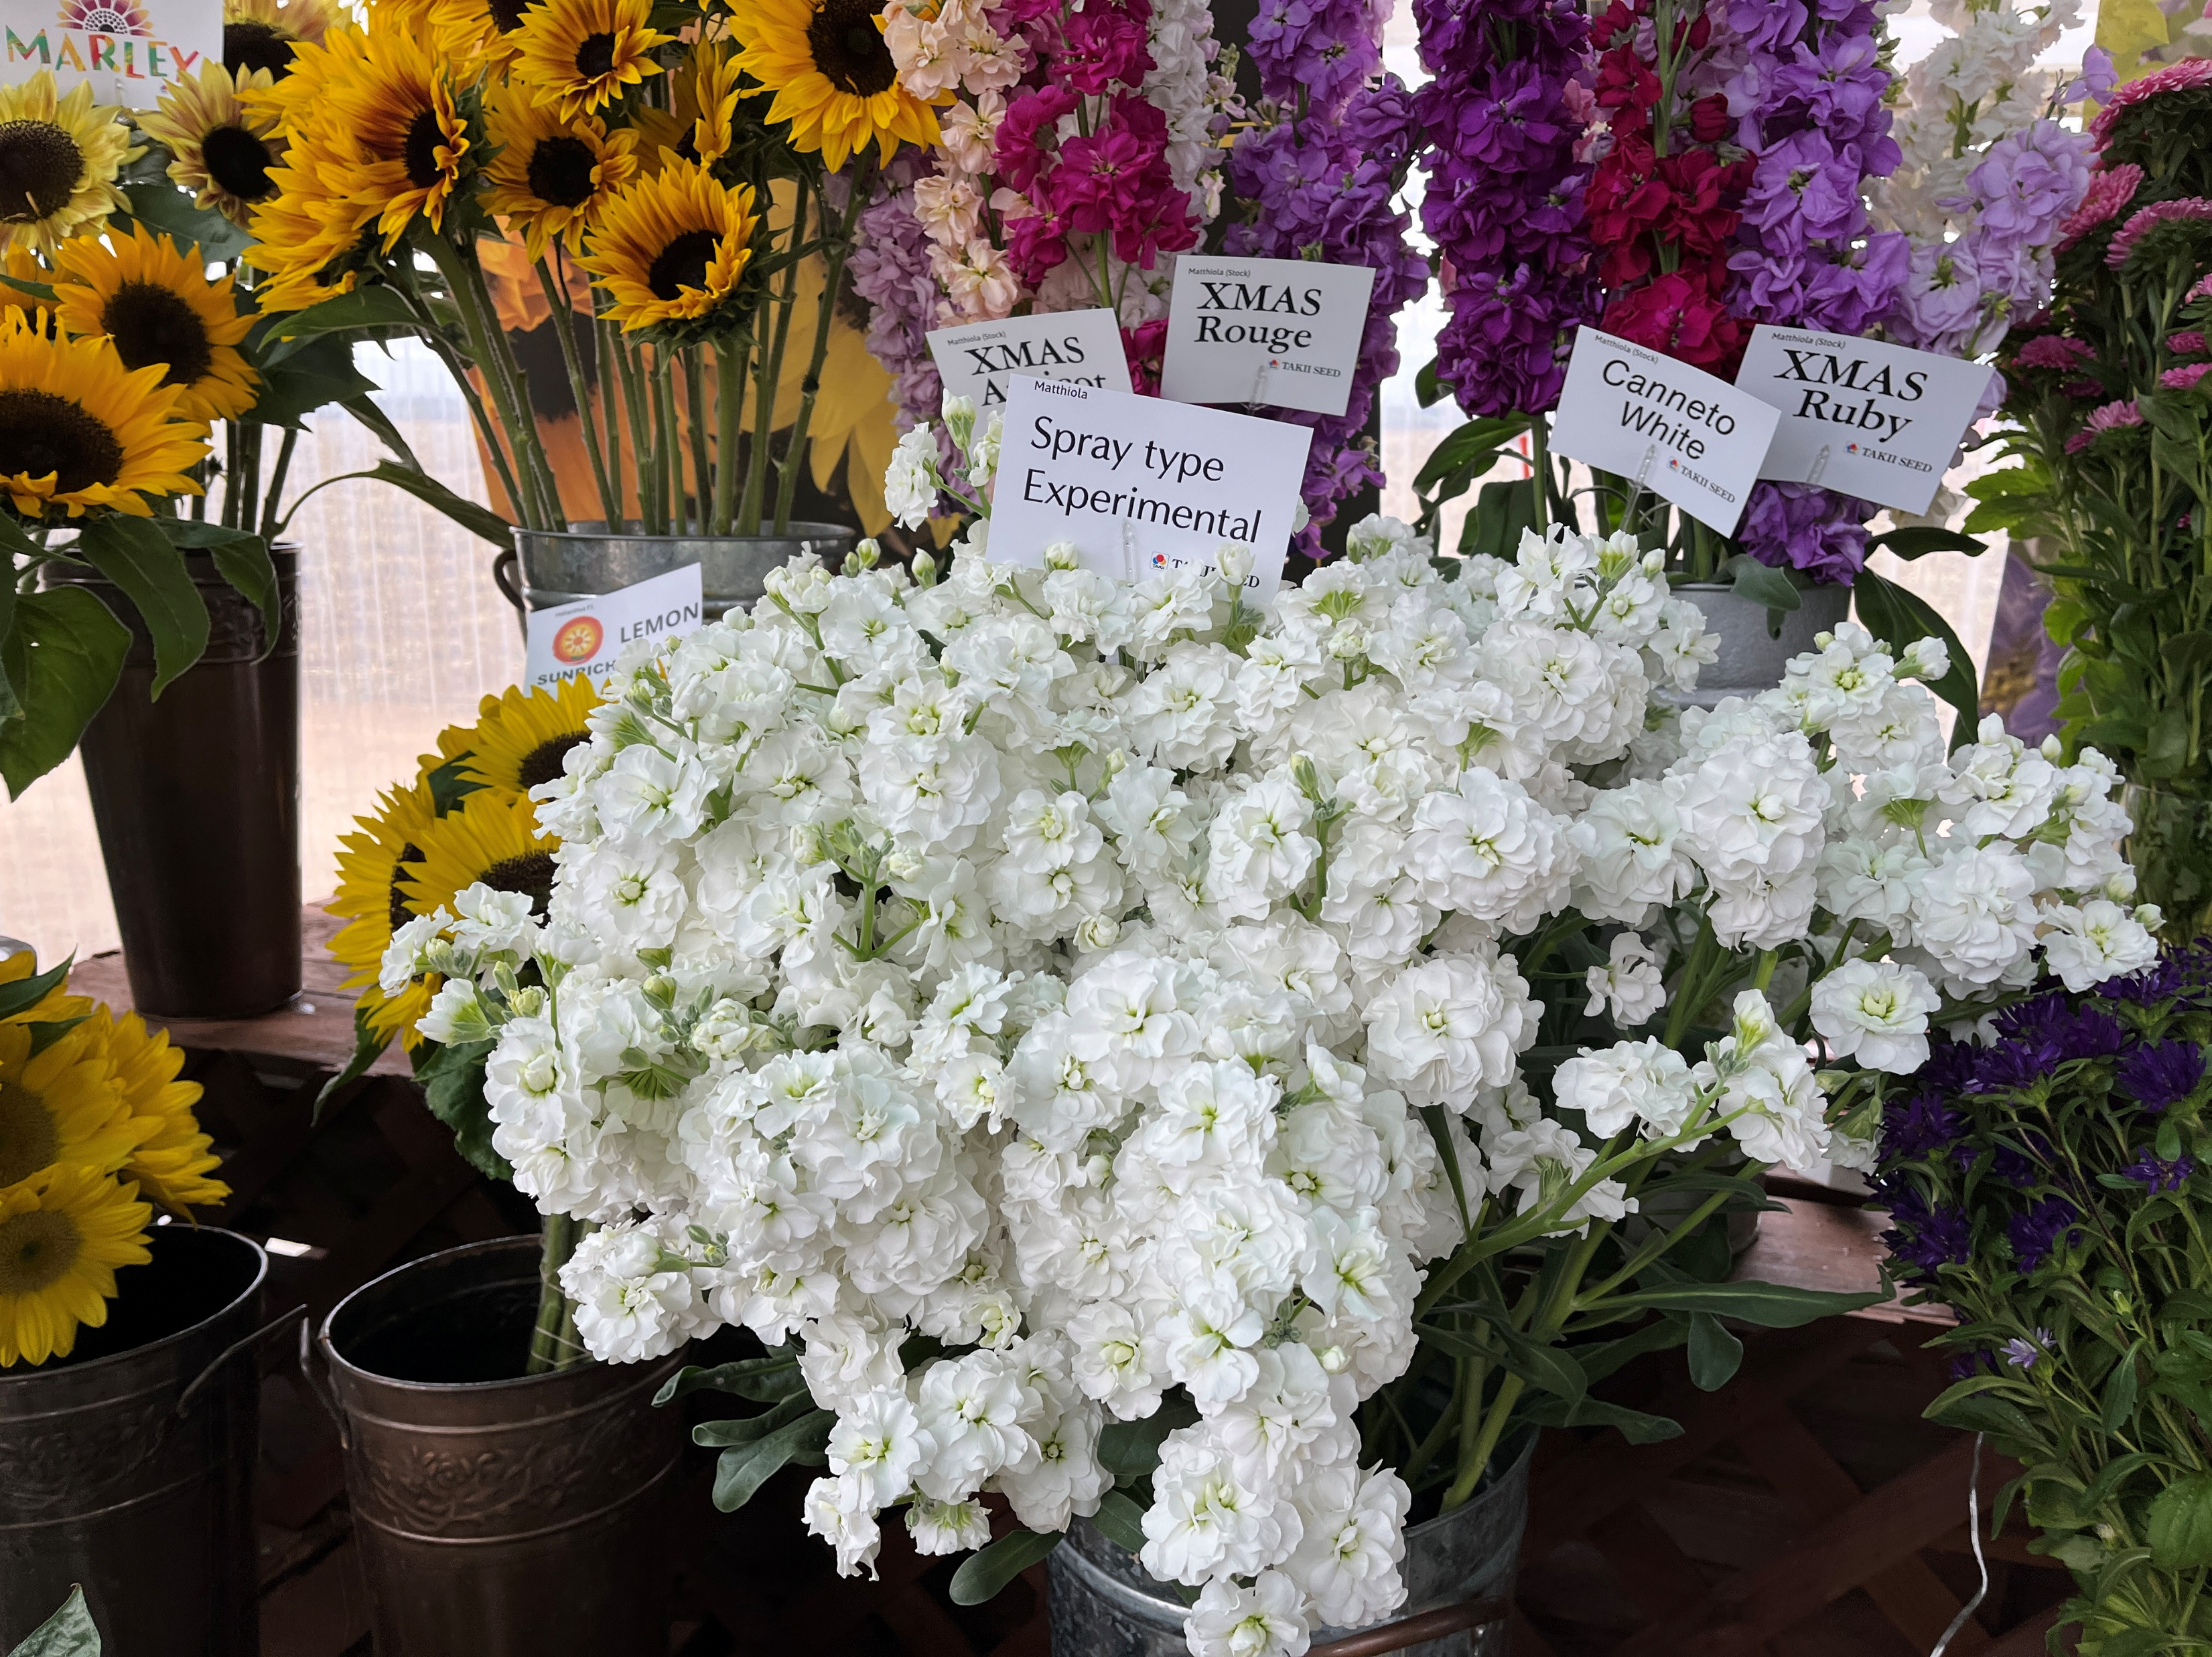
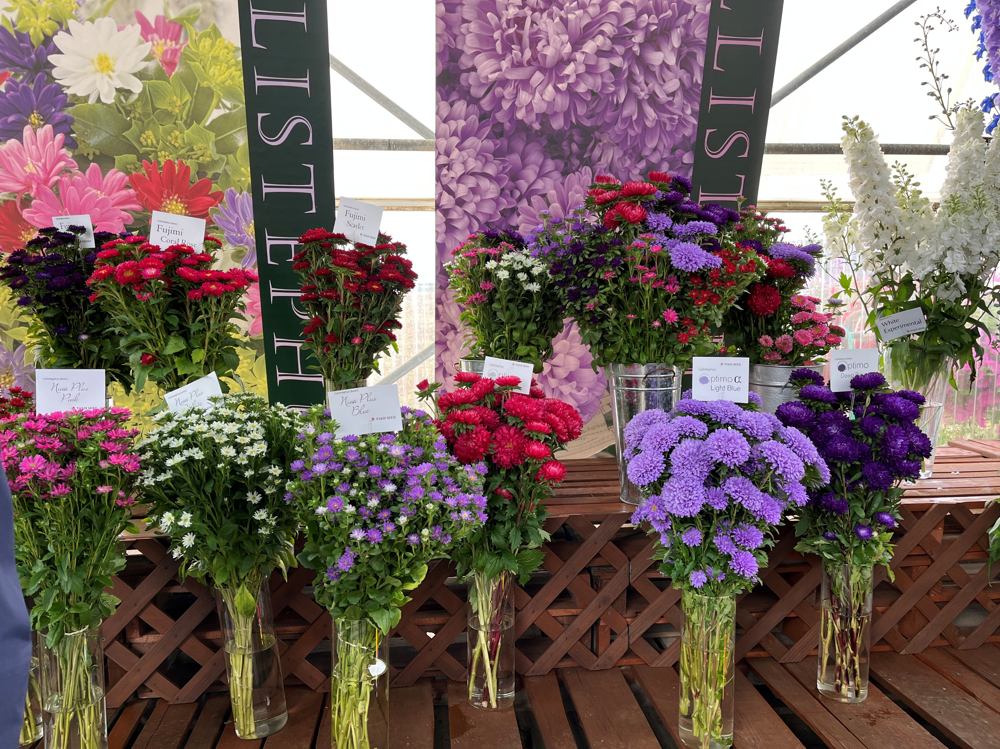
Cut Flowers
Sunflowers Sunrich
Brassica Crane
Asters
Stock

